Slide 1
Multiple access

Slide 2
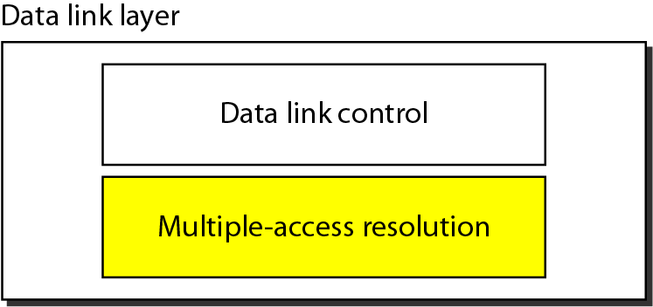
Data link layer divided into two functionality-oriented sublayers

Slide 3
_{Data Link control}
The data link control is responsible for reliable transmission of message over transmission channel by using techniques like framing, error control and flow control.
_{Multiple Access Control}
Dedicated link between the sender and the receiver then data link control layer is sufficient
There is no dedicated link present then multiple stations can access the channel simultaneously.
Hence multiple access protocols are required to decrease collision and avoid crosstalk.

Slide 4
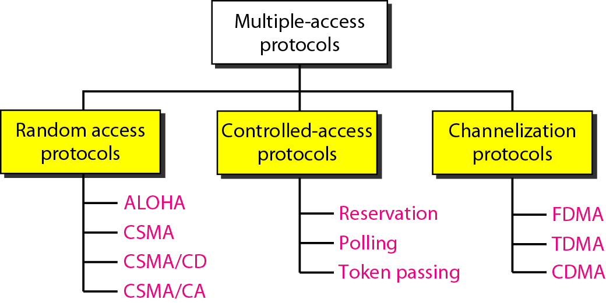
Taxonomy of multiple-access protocols

Slide 5
RANDOM ACCESS
In random access or contention methods, no station is superior to another station and none is assigned the control over another. No station permits, or does not permit, another station to send. At each instance, a station that has data to send uses a procedure defined by the protocol to make a decision on whether or not to send.
ALOHA
Carrier Sense Multiple Access
Carrier Sense Multiple Access with Collision Detection
Carrier Sense Multiple Access with Collision Avoidance

Slide 6
ALOHA
1970 Hawaii
Norman Abramson and colleagues have enabled wireless communication between users in a remote island to the central computer in Honolulu.
Two versions of the protocol now called ALOHA:
  Pure ALOHA and
  Slotted ALOHA

Slide 7
Aloha
If you have a packet, just send it.
If multiple people try it and so there is collision, then try resending it later!
Theoretical analysis (based on Poisson distribution) shows a throughput of only 18%.

Slide 8
Pure ALOHA
Each user is free to transmit whenever they have data to be sent.
  There will be collisions
  Senders need some way to fond out if this is the case.
In ALOHA after the satiation transmits its message to the central computer, the computer rebroadcast's the frame to all of the stations.
  Original sending station can listen for the broadcast from the hub to see if its frame has gone through.

Slide 9
Pure ALOHA
  In other wired systems the sender might be able to listen for collisions while transmitting.
If the frame is destroyed, the sender just waits a random amount of time and sends it again.
  Waiting time must be random or the sending frames will collide over and over.
  Contention systems: that use the same channel in the way that might lead to conflicts.

Slide 10
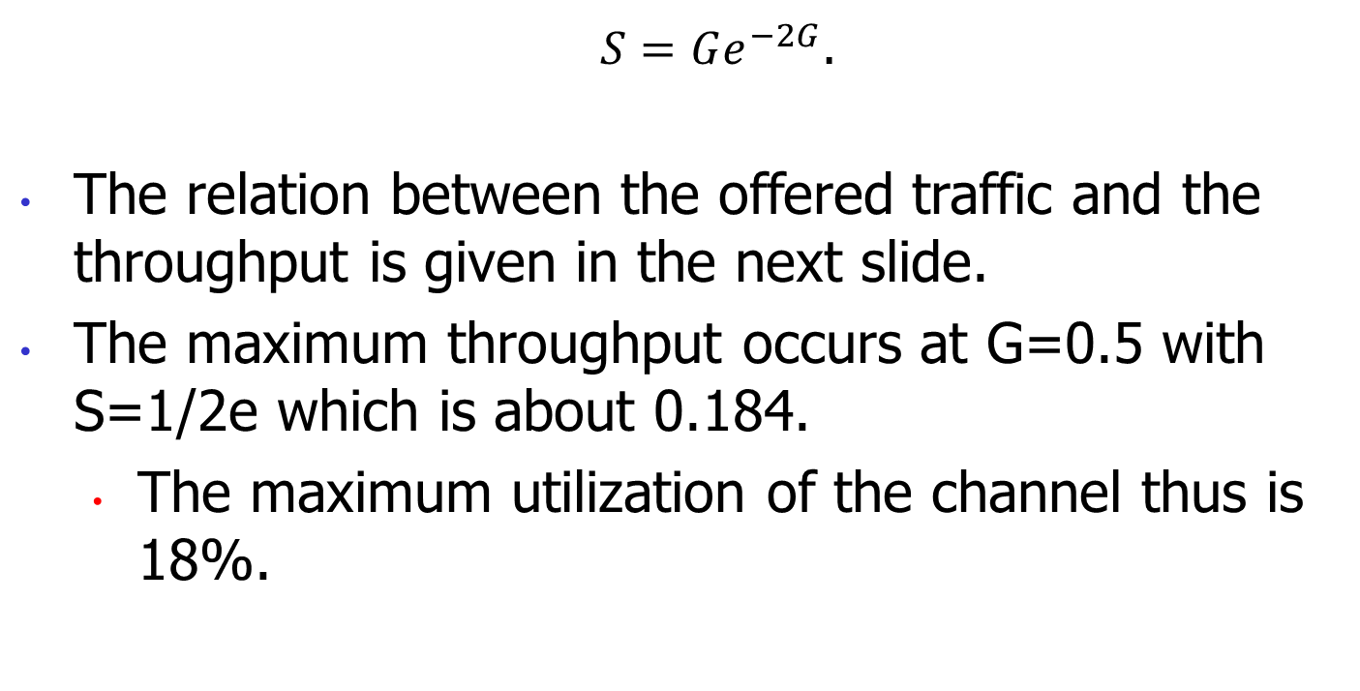
Pure ALOHA

Slide 11
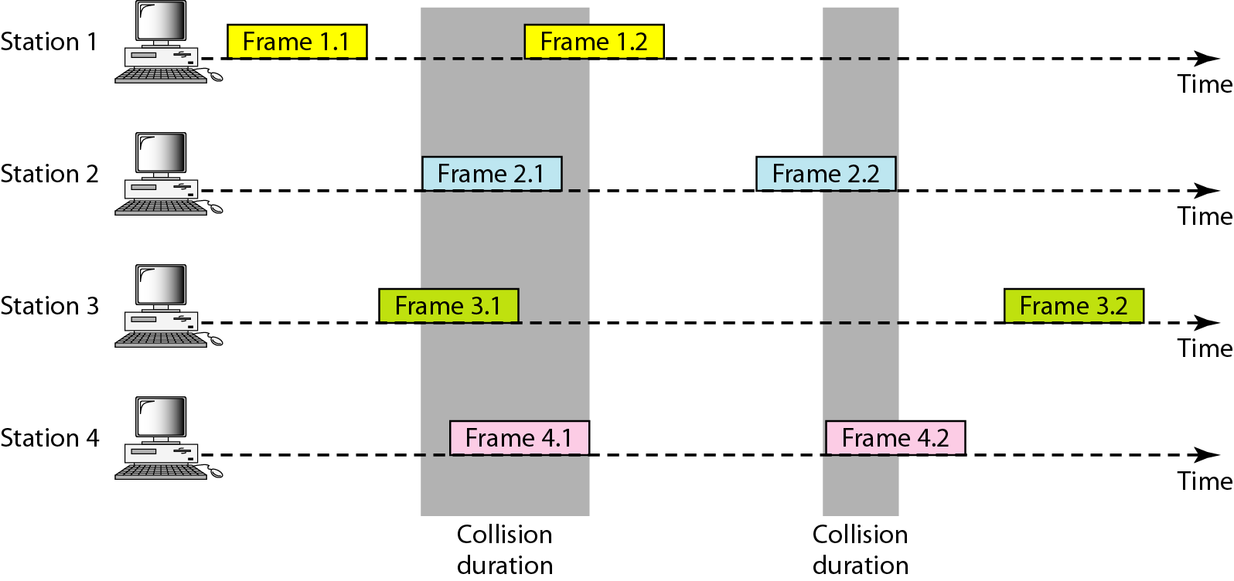
Frames in a pure ALOHA network

Slide 12
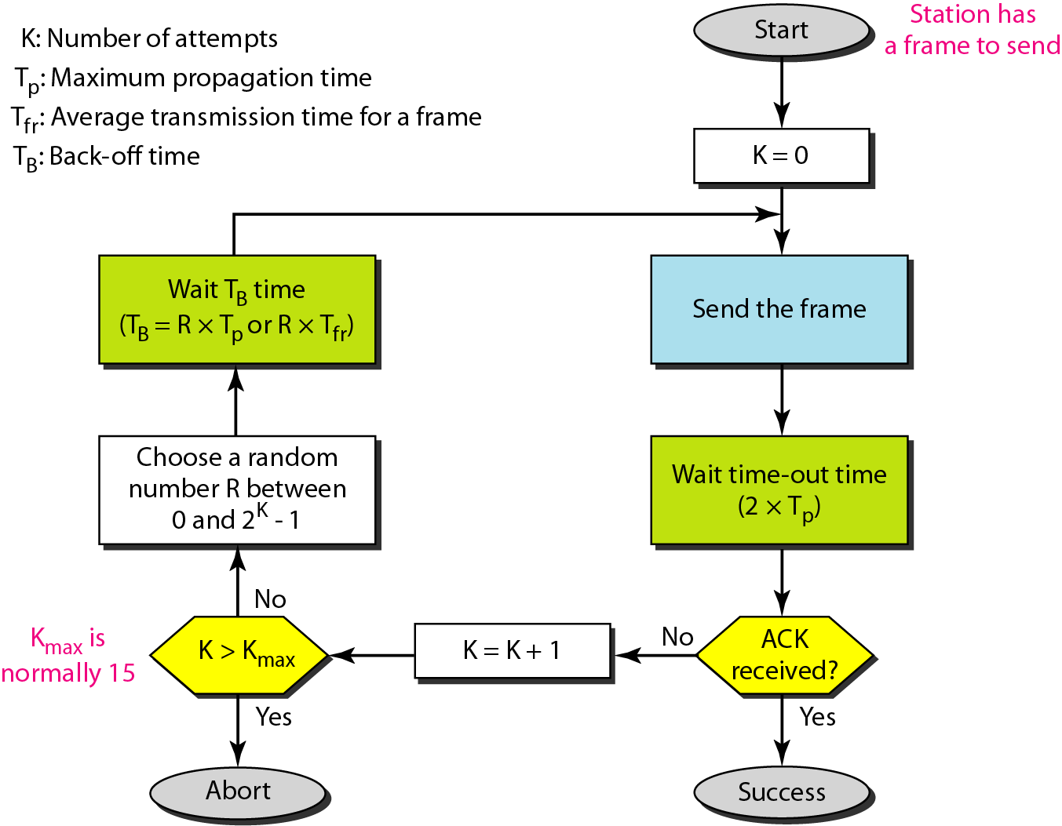
Procedure for pure ALOHA protocol

Slide 13
Example
The stations on a wireless ALOHA network are a maximum of 600 km apart. If we assume that signals propagate at 3 × 10⁸ m/s, we find
Tp = (600 × 10³ ) / (3 × 10⁸ ) = 2 ms.
Now we can find the value of T_{B} for different values of
K .
a. For K = 1, the range is {0, 1}. The station needs to|
generate a random number with a value of 0 or 1. This
means that T_{B} is either 0 ms (0 × 2) or 2 ms (1 × 2),
based on the outcome of the random variable.

Slide 14
Example
b. For K = 2, the range is {0, 1, 2, 3}. This means that T_{B}
can be 0, 2, 4, or 6 ms, based on the outcome of the
random variable.
c. For K = 3, the range is {0, 1, 2, 3, 4, 5, 6, 7}. This
means that T_{B} can be 0, 2, 4, . . . , 14 ms, based on the
outcome of the random variable.
d. We need to mention that if K > 10, it is normally set to
10.

Slide 15
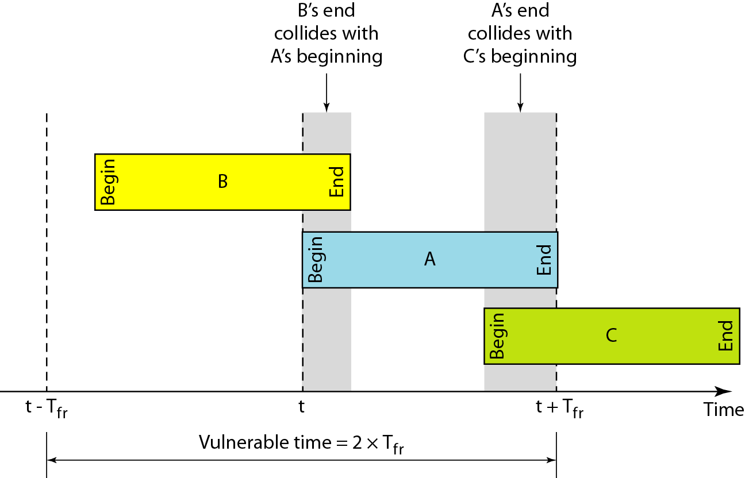
Vulnerable time for pure ALOHA protocol

Slide 16
Example
A pure ALOHA network transmits 200-bit frames on a shared channel of 200 kbps. What is the requirement to make this frame collision-free?
Solution
Average frame transmission time T_{fr} is 200 bits/200 kbps or 1 ms. The vulnerable time is 2 × 1 ms = 2 ms. This means no station should send later than 1 ms before this station starts transmission and no station should start sending during the one 1-ms period that this station is sending.

Slide 17
The throughput for pure ALOHA is
S = G × e ^{−2G} .
The maximum throughput
S_{max} = 0.184 when G= (1/2).

Slide 18
Example
A pure ALOHA network transmits 200-bit frames on a shared channel of 200 kbps. What is the throughput if the system (all stations together) produces
a. 1000 frames per second b. 500 frames per second
c. 250 frames per second.
Solution
The frame transmission time is 200/200 kbps or 1 ms.
a. If the system creates 1000 frames per second, this is 1 frame per millisecond. The load is 1. In this case
S = G× e^{−2 G} or S = 0.135 (13.5 percent). This means
that the throughput is 1000 × 0.135 = 135 frames. Only
135 frames out of 1000 will probably survive.

Slide 19
Example
b. If the system creates 500 frames per second, this is
(1/2) frame per millisecond. The load is (1/2). In this
case S = G × e ^{−2G} or S = 0.184 (18.4 percent). This
means that the throughput is 500 × 0.184 = 92 and that
only 92 frames out of 500 will probably survive. Note
that this is the maximum throughput case,
percentagewise.
c. If the system creates 250 frames per second, this is (1/4)
frame per millisecond. The load is (1/4). In this case
S = G × e −^{2G} or S = 0.152 (15.2 percent). This means
that the throughput is 250 × 0.152 = 38. Only 38
frames out of 250 will probably survive.

Slide 20
Slotted ALOHA
Roberts in 1972 doubled the capacity of an ALOHA system.
  Divide time into discrete intervals called slots.
  Each interval corresponds to one frame.
  Users will have to agree on slot boundaries.
Synchronization is required:
  One special station emit a pip at the start of each interval, like clock.

Slide 21
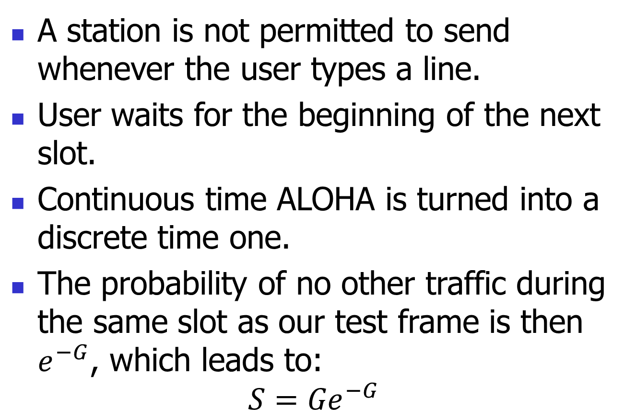
Sloted ALOHA

Slide 22
Slotted ALOHA
Slotted ALOHA
  peaks at the G = 1
  Throughput S = 1/e = 0.367 or 37%.
The best case scenario:
  37% of slots are empty
  37% of successes, and
  26% collisions.

Slide 23
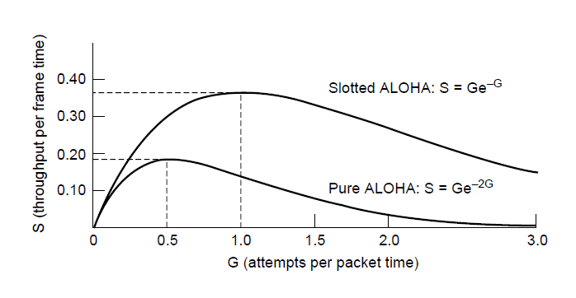
ALOHA (3)
Throughput versus offered traffic for ALOHA systems.

Slide 24
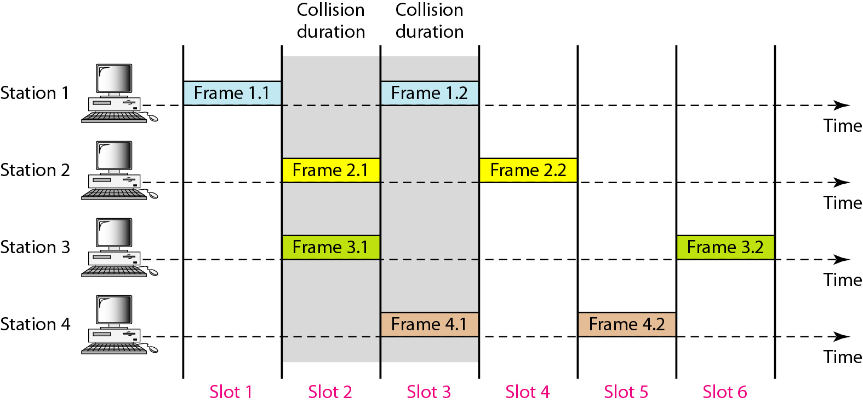
Frames in a slotted ALOHA network

Slide 25
The throughput for slotted ALOHA is
S = G × e^{−G} .
The maximum throughput
S_{max} = 0.368 when G = 1.

Slide 26
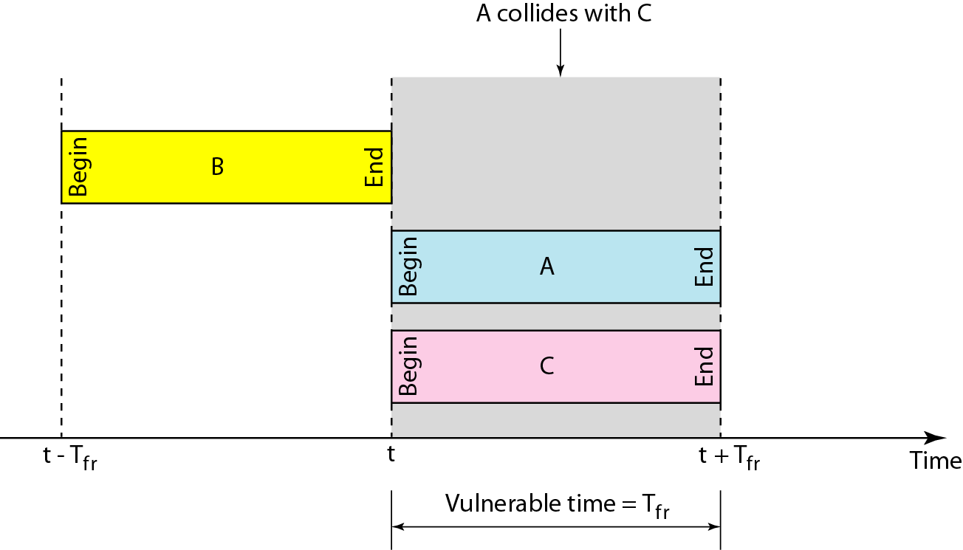
Vulnerable time for slotted ALOHA protocol

Slide 27
Example
A slotted ALOHA network transmits 200-bit frames on a shared channel of 200 kbps. What is the throughput if the system (all stations together) produces
a. 1000 frames per second b. 500 frames per second
c. 250 frames per second.
Solution
The frame transmission time is 200/200 kbps or 1 ms.
a. If the system creates 1000 frames per second, this is 1 frame per millisecond. The load is 1. In this case S = G× e^{−G} or S = 0.368 (36.8 percent). This means
that the throughput is 1000 × 0.0368 = 368 frames.
Only 386 frames out of 1000 will probably survive.

Slide 28
Example
b. If the system creates 500 frames per second, this is
(1/2) frame per millisecond. The load is (1/2). In this
case S = G × e^{−G} or S = 0.303 (30.3 percent). This
means that the throughput is 500 × 0.0303 = 151.
Only 151 frames out of 500 will probably survive.
c. If the system creates 250 frames per second, this is (1/4) frame per millisecond. The load is (1/4). In this case S = G × e ^{−G} or S = 0.195 (19.5 percent). This means that the throughput is 250 × 0.195 = 49. Only 49
frames out of 250 will probably survive.

Slide 29
Pure Aloha | Slotted Aloha
Any station can transmit the data at any time. | Any station can transmit the data at the beginning of any time slot.
The time is continuous and not globally synchronized. | The time is discrete and globally synchronized.
Vulnerable time in which collision may occur = 2 x T_{t} | Vulnerable time in which collision may occur = T_{t}
Probability of successful transmission of data packet = G x e-^{2G} | Probability of successful transmission of data packet = G x e-^{G}
Maximum efficiency = 18.4% (Occurs at G = 1/2) | Maximum efficiency = 36.8% ( Occurs at G = 1)
The main advantage of pure aloha is its simplicity in implementation. | The main advantage of slotted aloha is that it reduces the number of collisions to half and doubles the efficiency of pure aloha

Slide 30
Carrier Sense Multiple Access (CSMA)
Protocols

Slide 31
Carrier Sense Multiple Access Protocols
Protocols in which stations listen for a carrier (i.e., transmission) and act accordingly are called carrier sense protocols.
Several Versions of those protocols will be discussed.
  Persistent and Nonpersistent CSMA
  CSMA with Collision Detections

Slide 32
Persistent and Nonpersistent CSMA
1-Persistend Carrier Sense Multiple Access (CSMA) protocol.
  When a station has data to be send it first listens to the channel to see if anyone else is transmitting at that moment.
  If the channel is idle the station sends the data,
  Otherwise, the station just waits until it becomes idle.

Slide 33
Persistent and Nonpersistent CSMA
1-Persistend Carrier Sense Multiple Access (CSMA) protocol.
  If a collision occurs, the station waits a random amount of time and starts all over again.
  This protocol has problems with collisions:
    2 patiently waiting stations will start transmitting at the same time when the channel becomes idle.
    Propagation delay can make even more subtle the collision.
1-persistent refers to the probability of 1 of transmission when the channel if found to be idle.

Slide 34
Persistent and Nonpersistent CSMA
Nonpersistent CSMA - Second Carrier Sense protocol is. In this protocol the transmitting stations are less greedy.
  The transmitting station will send the packet if the channel is found to be idle, however
  If the channel is already in use the station does not continuously sense it for transmission. Instead it waits a random amount of time and then repeats the algorithm.

Slide 35
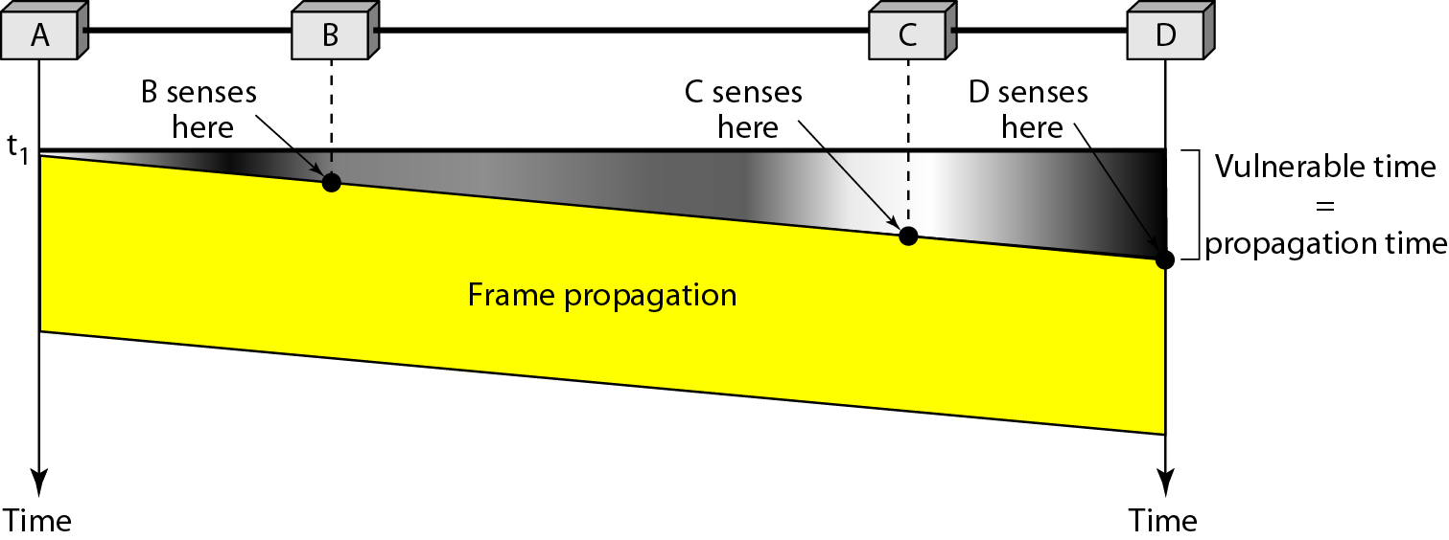
Vulnerable time in CSMA

Slide 36
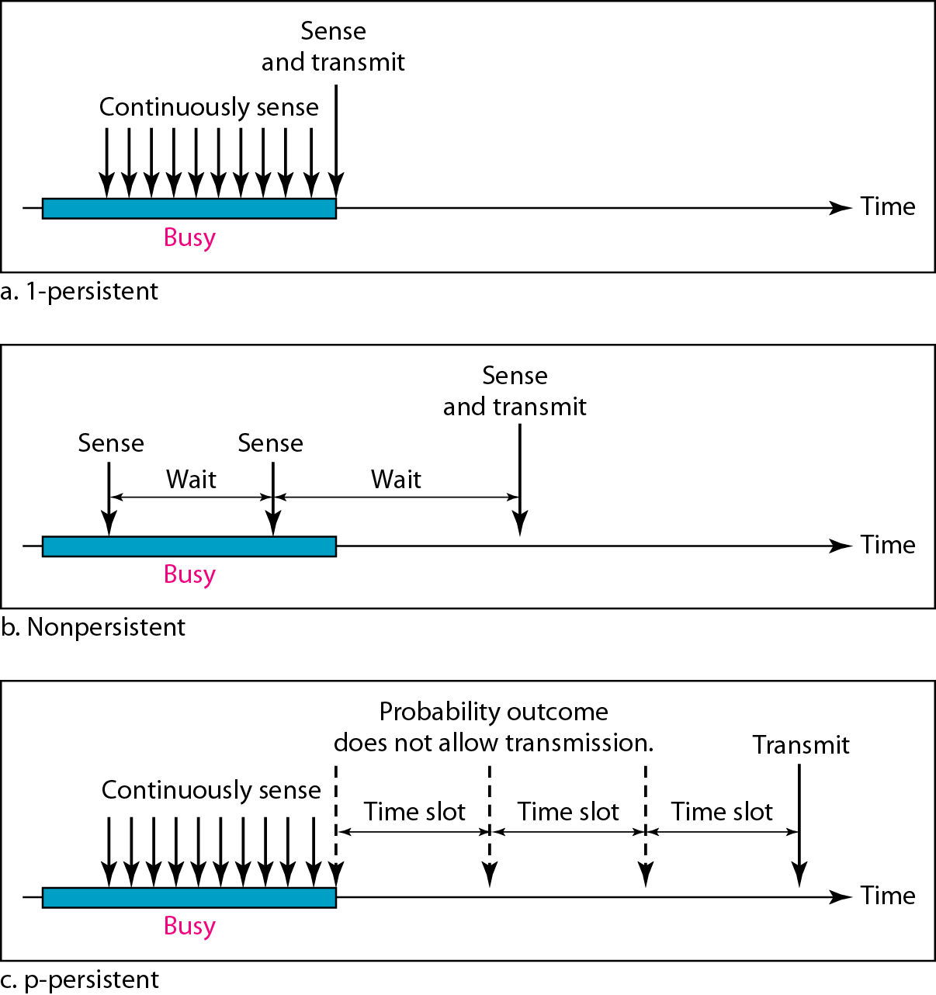
Behavior of three persistence methods

Slide 37
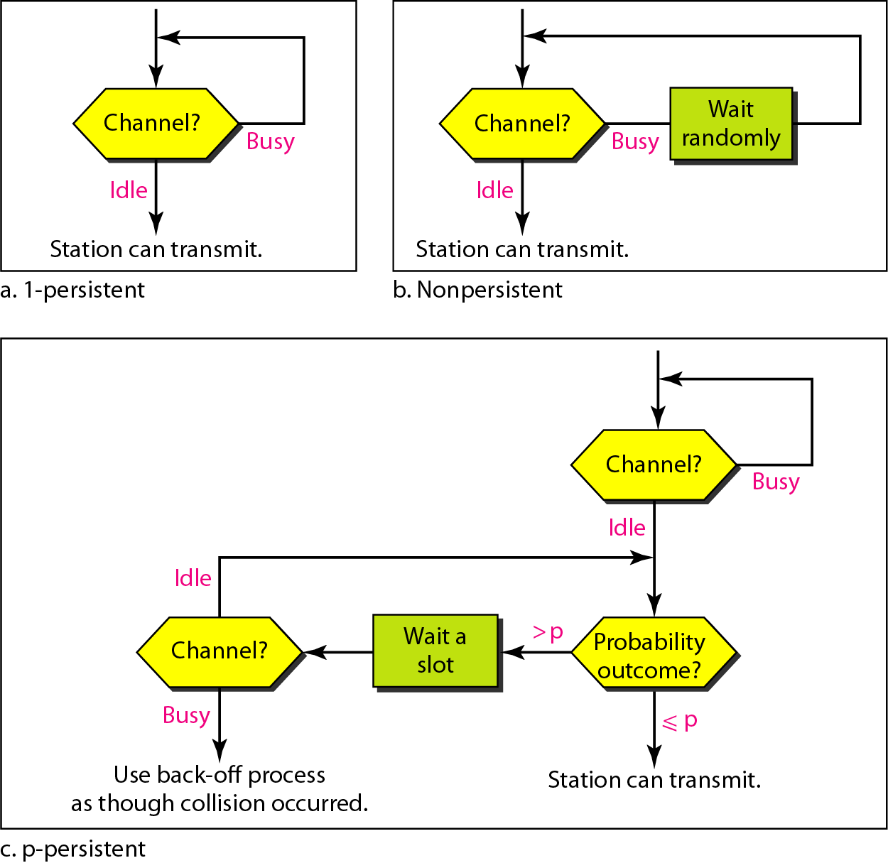
Flow diagram for three persistence methods

Slide 38
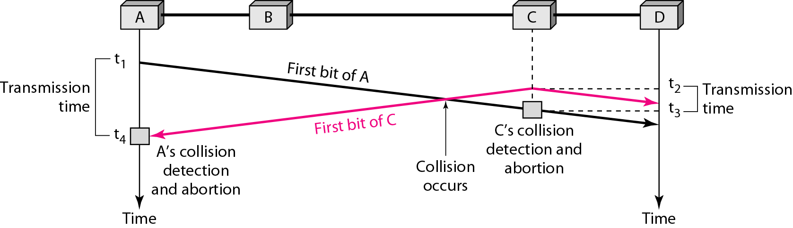
Collision of the first bit in CSMA/CD

Slide 39
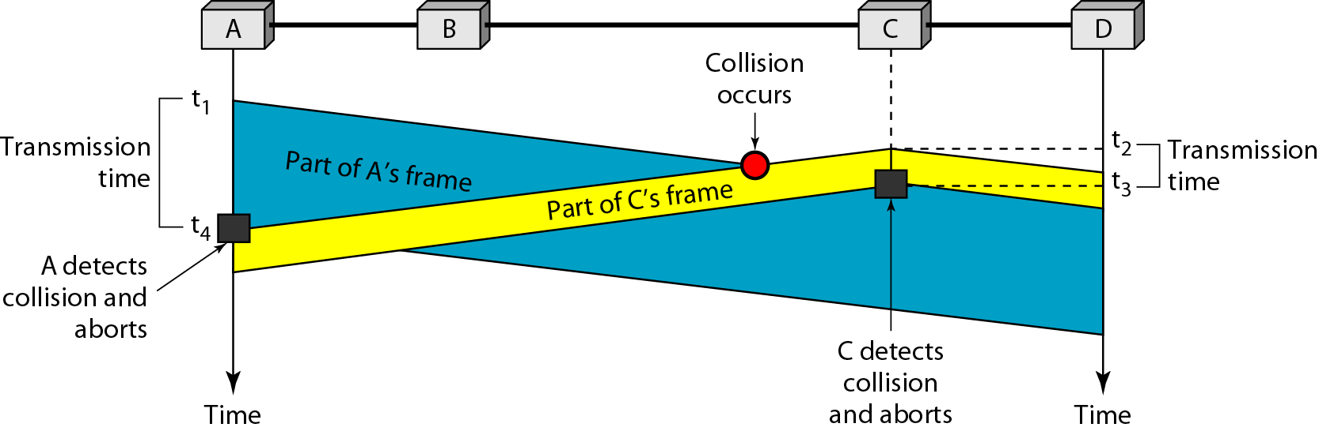
Collision and abortion in CSMA/CD

Slide 40
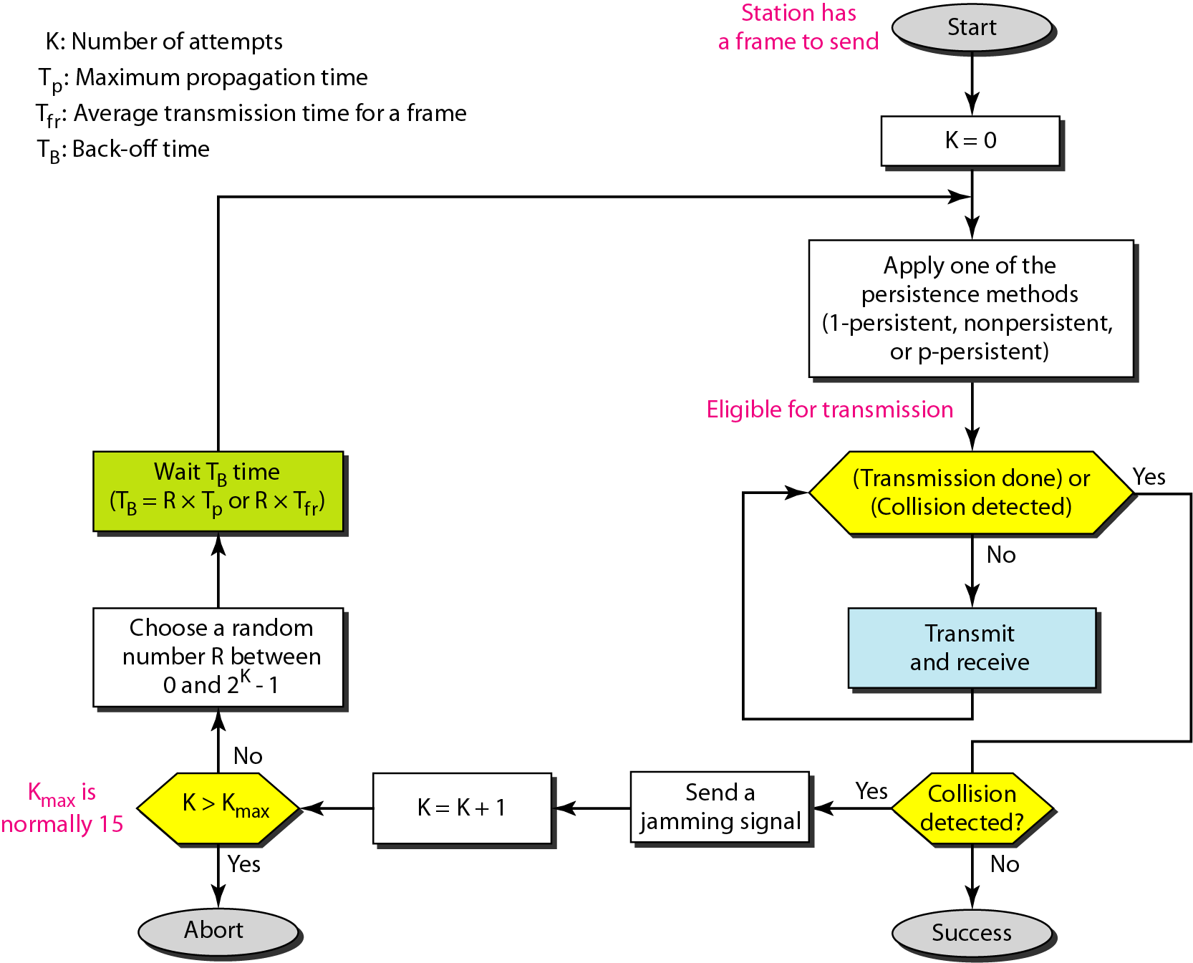
Flow diagram for the CSMA/CD

Slide 41
Problem 1 — Minimum Frame Size
A CSMA/CD LAN has a bandwidth of 10 Mbps. The maximum distance between two stations is 2500 m, and the propagation speed is 2 * 10^8 m/s. Find the minimum frame size required.

Slide 42
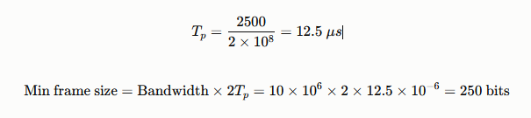

Slide 43
Problem 2 — Given Frame Size, Find Max Distance
A 10 Mbps CSMA/CD network has a minimum frame size of 512 bits. If the propagation speed is $2 \times 10^8$ m/s, what is the maximum allowable distance between two stations?

Slide 44
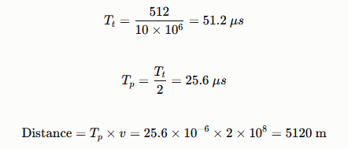

Slide 45
Problem 3 — Efficiency Calculation
A CSMA/CD LAN has bandwidth 10 Mbps, frame size 1000 bits, and Tp=25.6 μs. Calculate the efficiency of the protocol.

Slide 46
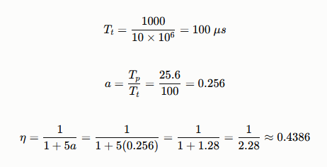

Slide 47
Problem 4 — Collision Detection Time
Two stations A and B are 2 km apart on a 10 Mbps CSMA/CD bus, with propagation speed 2 * 10^8 m/s. If A starts transmitting at t=0 and B starts transmitting (having sensed the channel idle, just before A's signal arrives) at t=9 μs, at what time does A detect the collision?

Slide 48
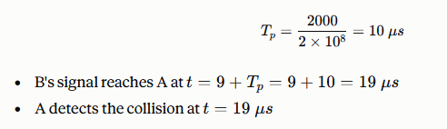

Slide 49
Problem 5 — Number of Stations vs. Slot Time (Binary Exponential Backoff)
In a CSMA/CD network, the slot time is 51.2 μs. After the 4th collision, a station uses binary exponential backoff. Calculate the range of possible backoff times.

Slide 50
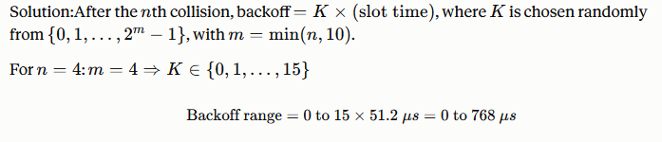

Slide 51
Example
A network using CSMA/CD has a bandwidth of 10 Mbps. If the maximum propagation time (including the delays in the devices and ignoring the time needed to send a jamming signal) is 25.6 μs, what is the minimum size of the frame?
Solution
The frame transmission time is T_{fr} = 2 × T_{p} = 51.2 μs. This means, in the worst case, a station needs to transmit for a period of 51.2 μs to detect the collision. The minimum size of the frame is 10 Mbps × 51.2 μs = 512 bits or 64 bytes. This is actually the minimum size of the frame for Standard Ethernet.

Slide 52
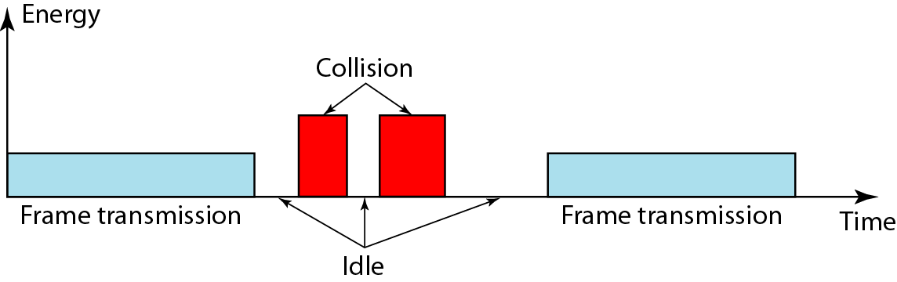
Energy level during transmission, idleness, or collision
On a wired network, energy level is almost double during a collision.
This is how a receiver tells if there is a collision.
But on a wireless network, energy level is not that high (barely 5-10%
higher). So with wireless, we need to avoid collisions.

Slide 53
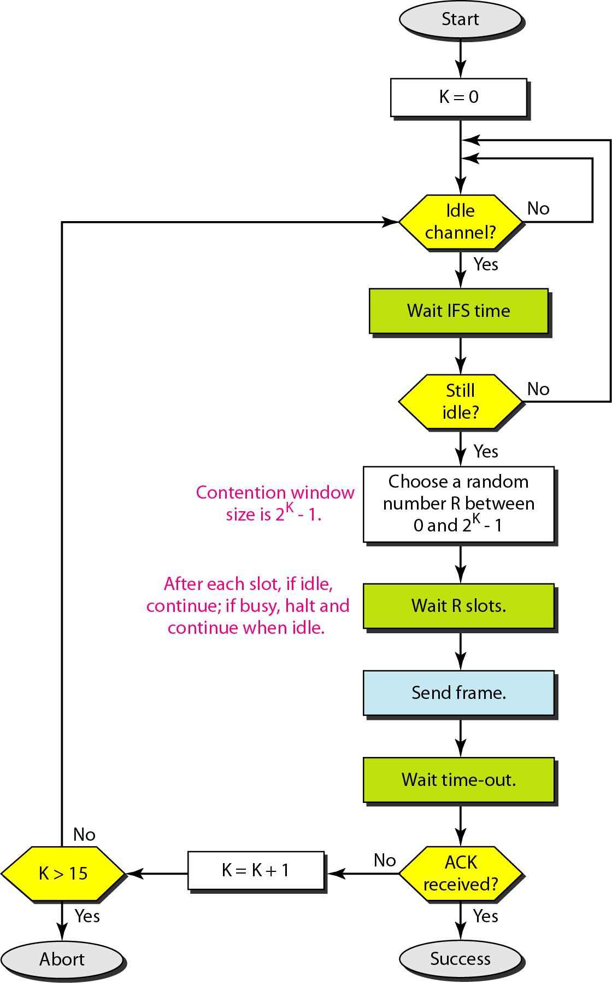
Flow diagram for CSMA/CA
Channel idle? Don’t transmit yet!
Wait IFS time.
Still idle after IFS? Don’t transmit yet!
Now in Contention Window.
Choose random number and wait that
many slots.
Did you wait R slots and all slots were
available? Go ahead, transmit.
Now, wait time-out for a response.
(How big is a slot? 50 µs in 802.11 FH and
20 µs in 802.11 DS)

Slide 54
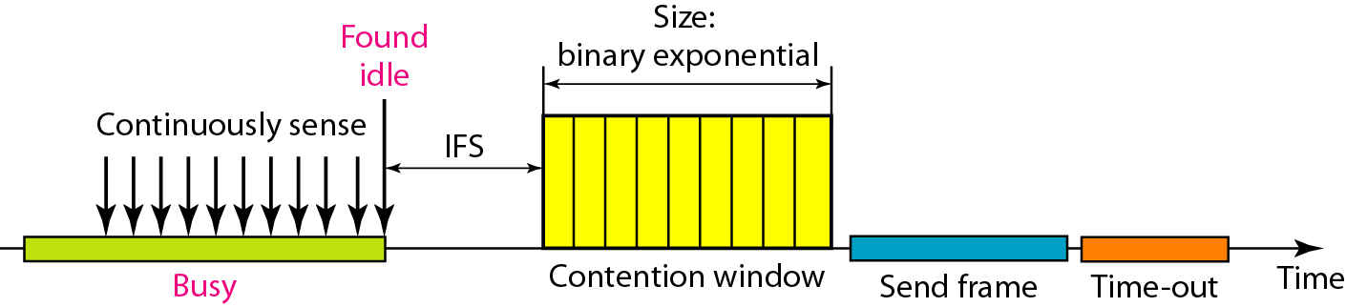
Timing in CSMA/CA
Collisions are avoided through the use of CSMA/CA's three strategies:
Interframe space (IFS)
contention window,
and acknowledgments

Slide 55

Note
In CSMA/CA, the IFS can also be used to define the priority of a station or a frame.

Slide 56
12-2 CONTROLLED ACCESS
In controlled access, the stations consult one another to find which station has the right to send. A station cannot send unless it has been authorized by other stations. We discuss three popular controlled-access methods.
Topics discussed in this section:
Reservation
Polling
Token Passing

Slide 57
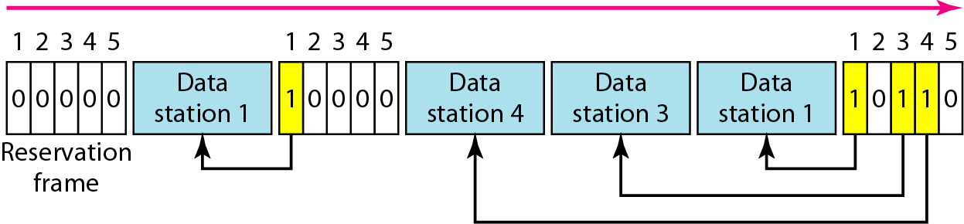
Figure 12.18 Reservation access method

Slide 58
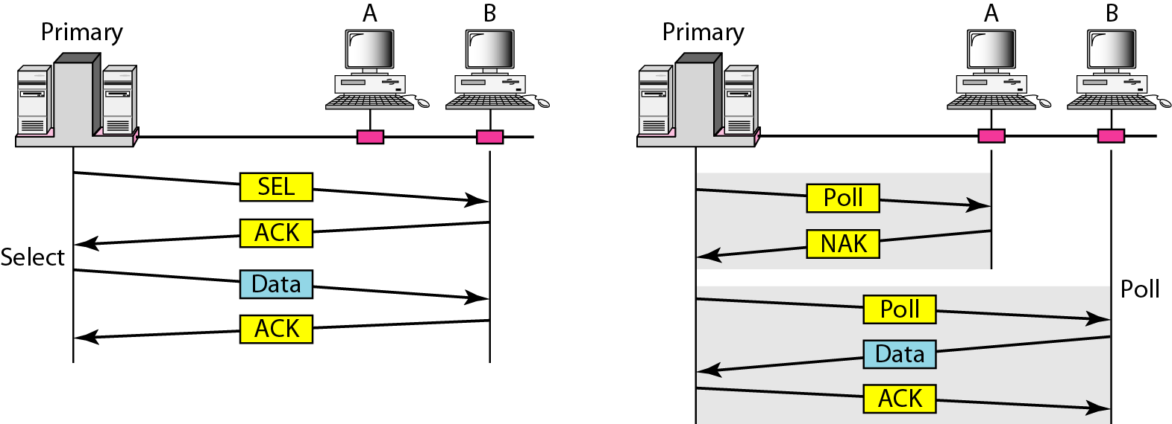
Figure 12.19 Select and poll functions in polling access method

Slide 59
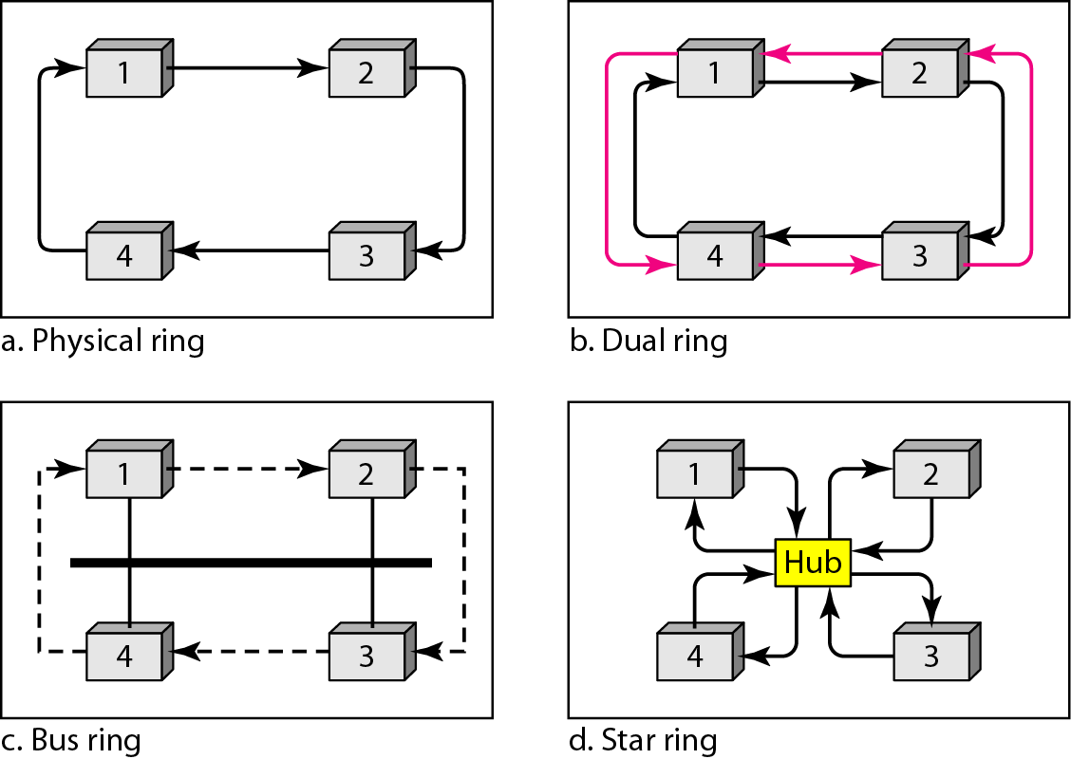
Figure 12.20 Logical ring and physical topology in token-passing access method

Slide 60
12-3 CHANNELIZATION
Channelization is a multiple-access method in which the available bandwidth of a link is shared in time, frequency, or through code, between different stations. In this section, we discuss three channelization protocols.
Topics discussed in this section:
Frequency-Division Multiple Access (FDMA)
Time-Division Multiple Access (TDMA)
Code-Division Multiple Access (CDMA)

Slide 61
Note
We see the application of all these methods in Chapter 16 when
we discuss cellular phone systems.

Slide 62
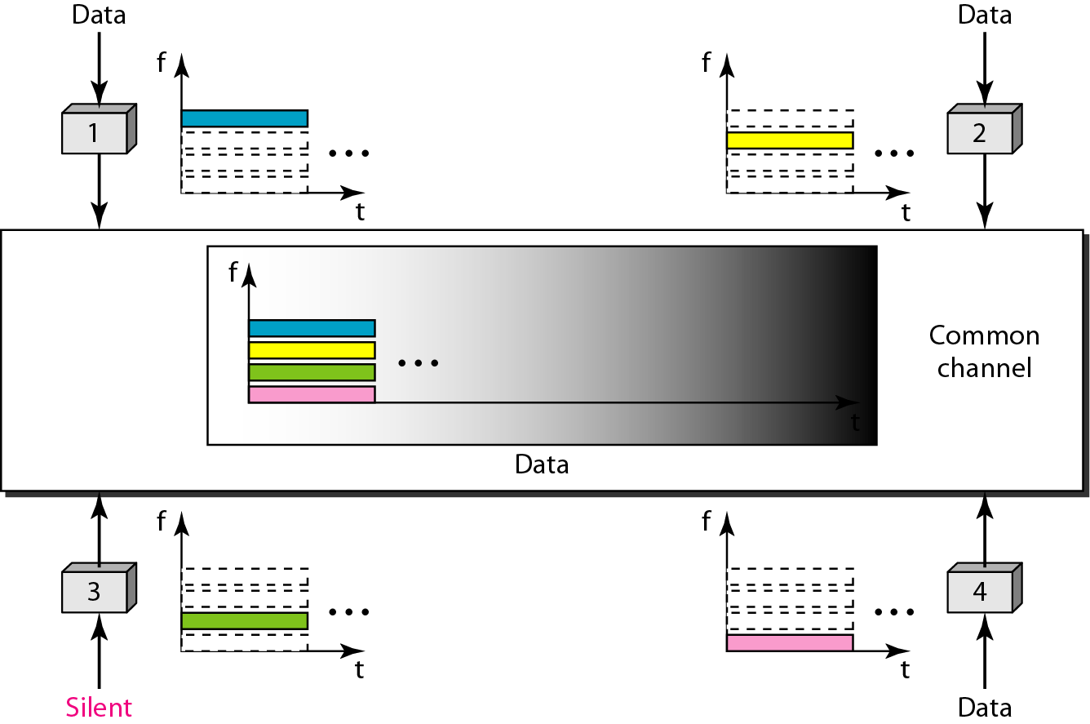
Figure 12.21 Frequency-division multiple access (FDMA)

Slide 63
Note
In FDMA, the available bandwidth
of the common channel is divided into bands that are separated by guard bands.

Slide 64
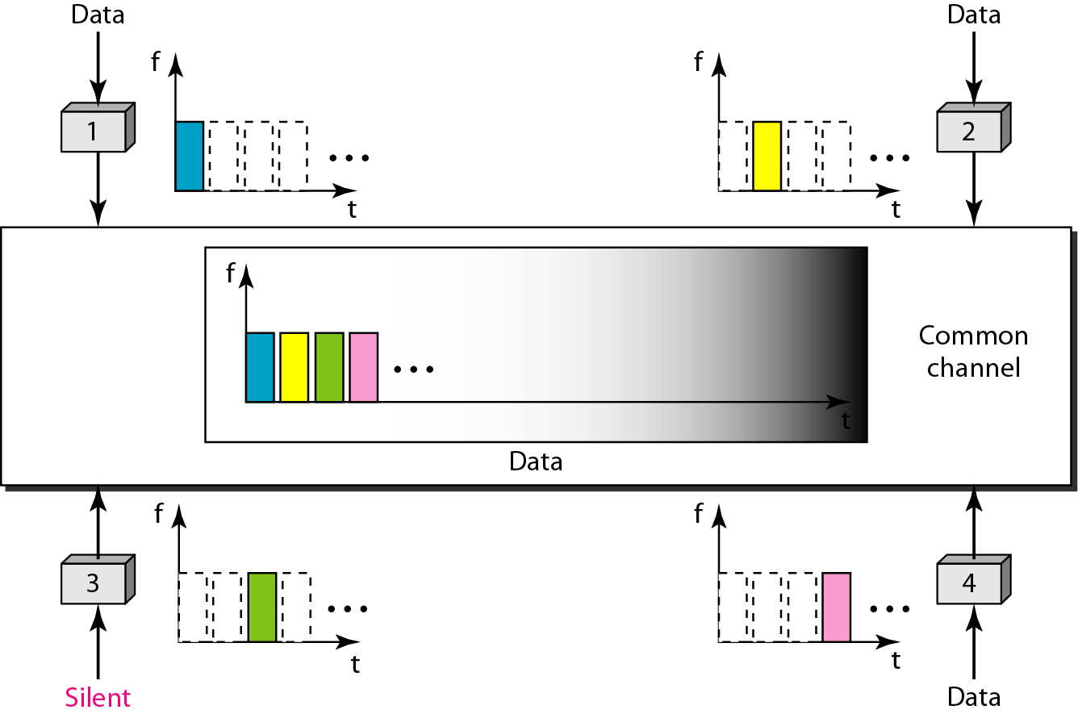
Figure 12.22 Time-division multiple access (TDMA)

Slide 65
Note
In TDMA, the bandwidth is just one channel that is timeshared between different stations.

Slide 66
Note
In CDMA, one channel carries all transmissions simultaneously.

Slide 67
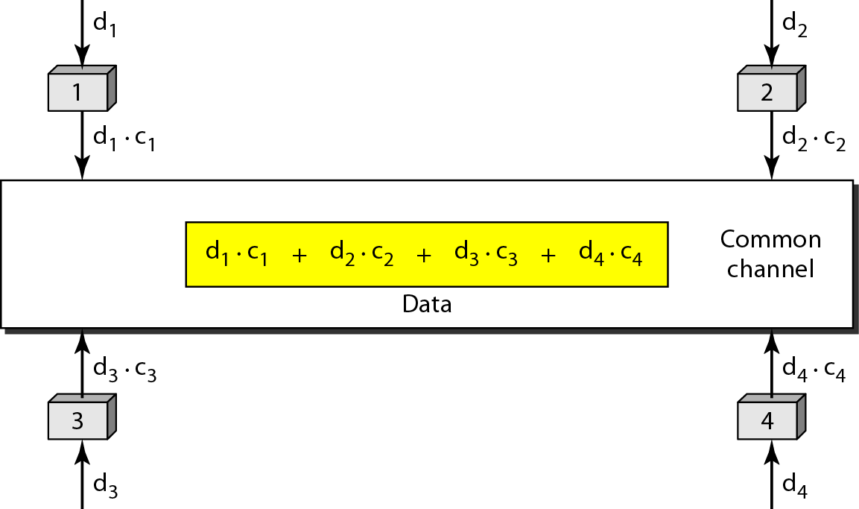
Figure 12.23 Simple idea of communication with code

Slide 68
Figure 12.24 Chip sequences

Slide 69
Figure 12.25 Data representation in CDMA

Slide 70
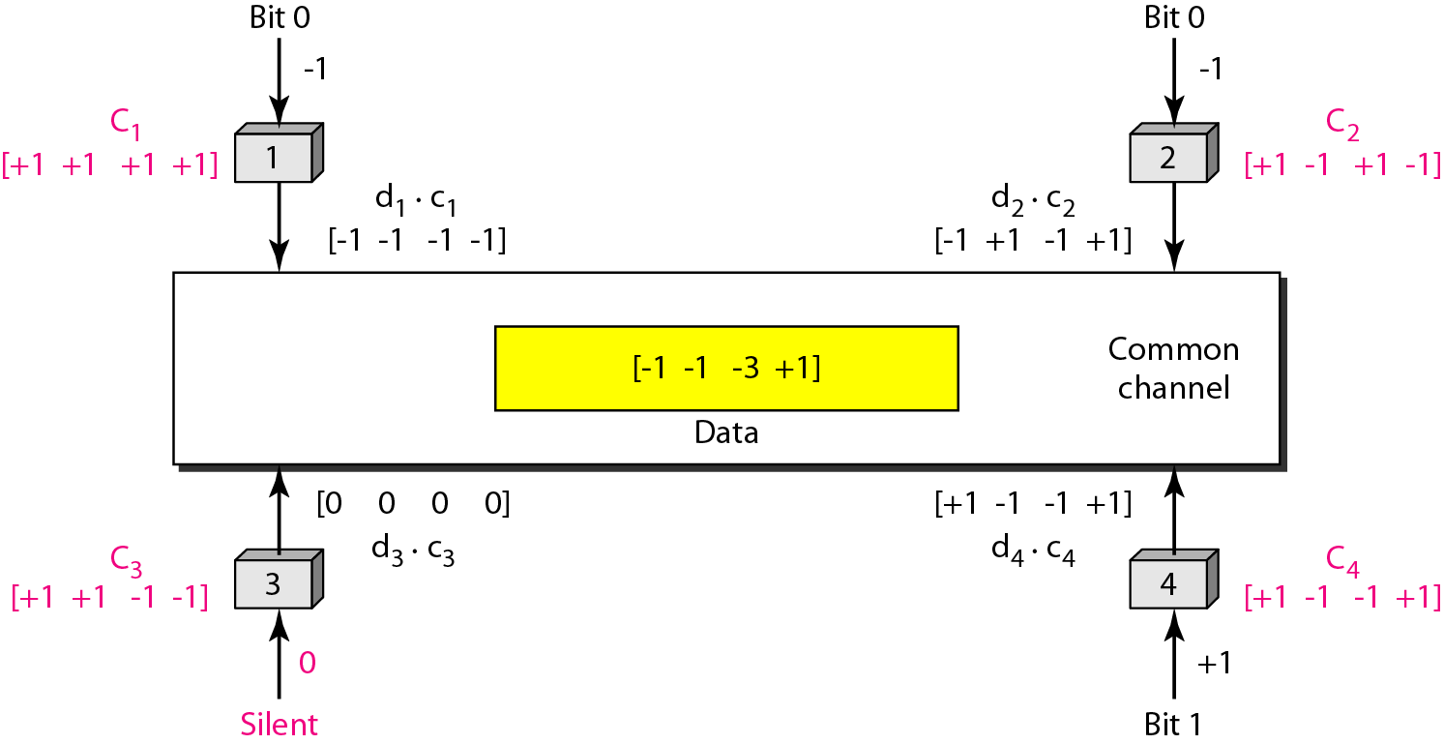
Figure 12.26 Sharing channel in CDMA

Slide 71
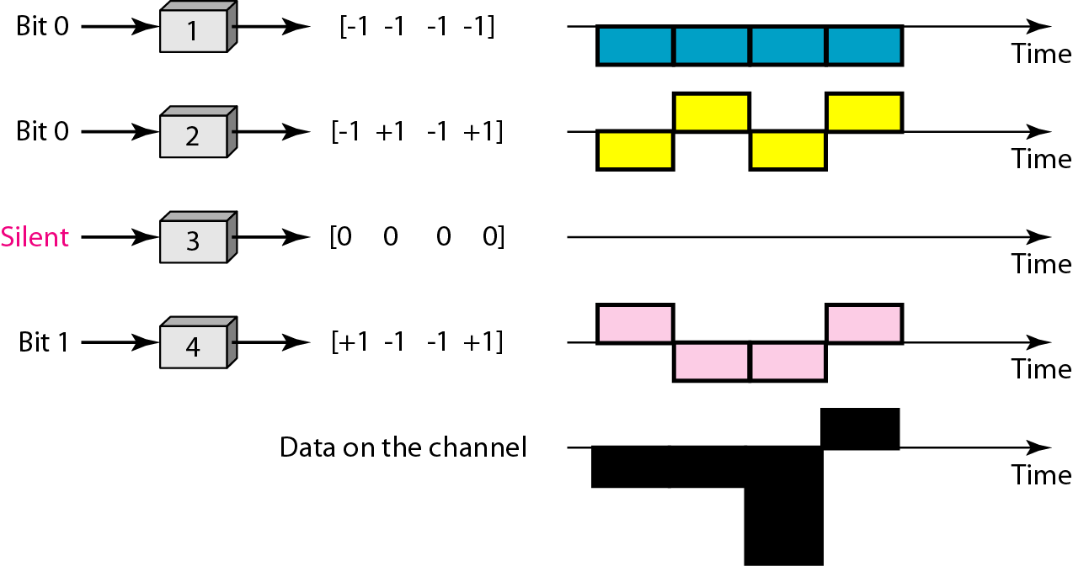
Figure 12.27 Digital signal created by four stations in CDMA

Slide 72
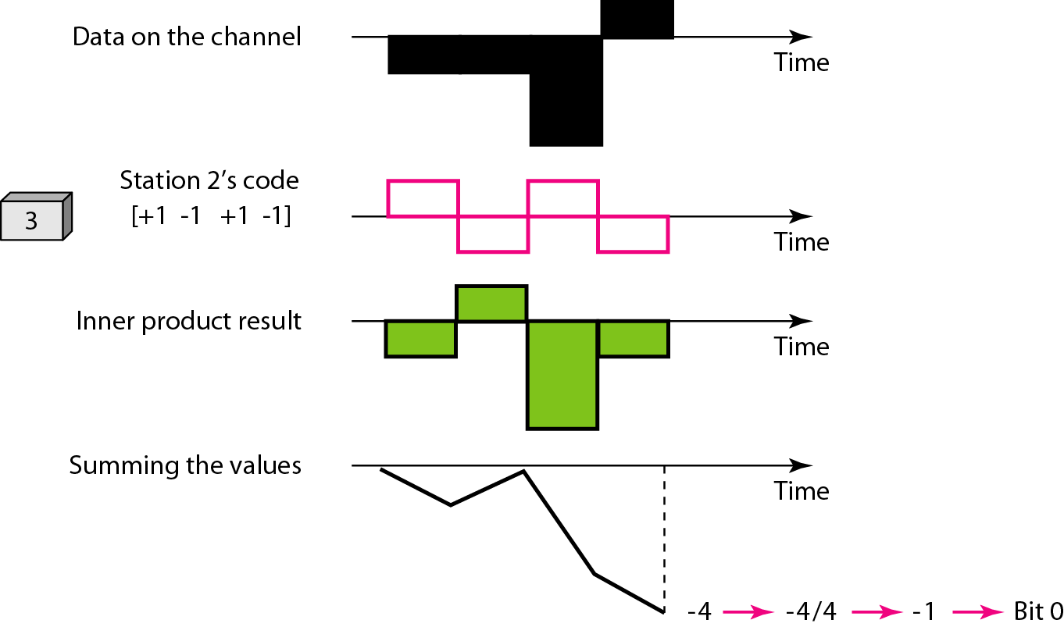
Figure 12.28 Decoding of the composite signal for one in CDMA

Slide 73
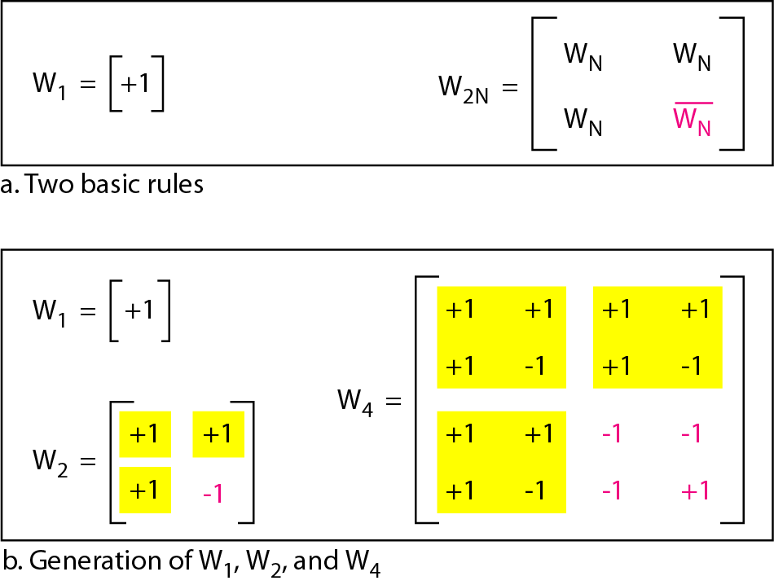
Figure 12.29 General rule and examples of creating Walsh tables

Slide 74
Note
The number of sequences in a Walsh table needs to be N = 2^{m}.

Slide 75
Example 12.6
Find the chips for a network with
a. Two stations b. Four stations
Solution
We can use the rows of W2 and W4 in Figure 12.29:
a. For a two-station network, we have
[+1 +1] and [+1 −1].
b. For a four-station network we have
[+1 +1 +1 +1], [+1 −1 +1 −1],
[+1 +1 −1 −1], and [+1 −1 −1 +1].

Slide 76
Example 12.7
What is the number of sequences if we have 90 stations in our network?
Solution
The number of sequences needs to be 2^{m}. We need to choose m = 7 and N = 2⁷ or 128. We can then use 90
of the sequences as the chips.

Slide 77
Example 12.8
Prove that a receiving station can get the data sent by a specific sender if it multiplies the entire data on the channel by the sender’s chip code and then divides it by the number of stations.
Solution
Let us prove this for the first station, using our previous four-station example. We can say that the data on the channel
D = (d1 ⋅ c1 + d2 ⋅ c2 + d3 ⋅ c3 + d4 ⋅ c4).
The receiver which wants to get the data sent by station 1 multiplies these data by c1.

Slide 78
Example 12.8 (continued)
When we divide the result by N, we get d1 .

